Slide 1
Classical Waterfall Model
The classical waterfall model is the basic software development life cycle model.
It is very simple but idealistic.
Earlier this model was very popular but nowadays it is not used.
But it is very important because all the other software development life cycle models are based on the classical waterfall model.

Slide 2
Why Do We Use the Waterfall Model?
The waterfall model is a software development model used in the context of large, complex projects, typically in the field of information technology. It is characterized by a structured, sequential approach to project management and software development.
The waterfall model is useful in situations where the project requirements are well-defined and the project goals are clear. It is often used for large-scale projects with long timelines, where there is little room for error and the project stakeholders need to have a high level of confidence in the outcome.

Slide 3
Features of the Waterfall Model
Sequential Approach: The waterfall model involves a sequential approach to software development, where each phase of the project is completed before moving on to the next one.
Document-Driven: The waterfall model relies heavily on documentation to ensure that the project is well-defined and the project team is working towards a clear set of goals.
Quality Control: The waterfall model places a high emphasis on quality control and testing at each phase of the project, to ensure that the final product meets the requirements and expectations of the stakeholders.

Slide 4
Features of the Waterfall Model
Rigorous Planning: The waterfall model involves a rigorous planning process, where the project scope, timelines, and deliverables are carefully defined and monitored throughout the project lifecycle.
Overall, the waterfall model is used in situations where there is a need for a highly structured and systematic approach to software development. It can be effective in ensuring that large, complex projects are completed on time and within budget, with a high level of quality and customer satisfaction

Slide 5
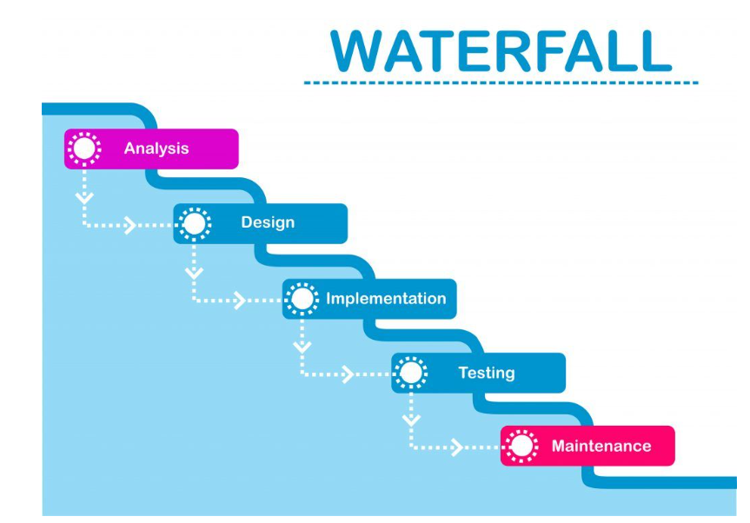

Slide 6
Phases of waterfall Model
Requirement gathering and analysis:
The first phase involves gathering requirements from stakeholders and analyzing them to understand the scope and objectives of the project.
Design: Once the requirements are understood, the design phase begins. This involves creating a detailed design document that outlines the software architecture, user interface, and system components.

Slide 7
Phases of waterfall Model
Implementation: The implementation phase involves coding the software based on the design specifications. This phase also includes unit testing to ensure that each component of the software is working as expected.
Testing: In the testing phase, the software is tested as a whole to ensure that it meets the requirements and is free from defects

Slide 8
Phases of waterfall Model
Implementation: The implementation phase involves coding the software based on the design specifications. This phase also includes unit testing to ensure that each component of the software is working as expected.
Testing: In the testing phase, the software is tested as a whole to ensure that it meets the requirements and is free from defects

Slide 9
Phases of waterfall Model
Deployment: Once the software has been tested and approved, it is deployed to the production environment.
Maintenance: The final phase of the Waterfall Model is maintenance, which involves fixing any issues that arise after the software has been deployed and ensuring that it continues to meet the requirements over time

Slide 10
Advantages of the Classical Waterfall Model
Easy to Understand: Classical Waterfall Model is very simple and easy to understand.
Individual Processing: Phases in the Classical Waterfall model are processed one at a time.
Properly Defined: In the classical waterfall model, each stage in the model is clearly defined.
Clear Milestones: Classical Waterfall model has very clear and well-understood milestones.
Properly Documented: Processes, actions, and results are very well documented.
Reinforces Good Habits: Classical Waterfall Model reinforces good habits like define-before-design and design-before-code.
Working: Classical Waterfall Model works well for smaller projects and projects where requirements are well understood.

Slide 11
Disadvantages of the Classical Waterfall Model
No Feedback Path
Difficult to accommodate Change Requests.
No Overlapping of Phases:
Limited Flexibility:
Limited Stakeholder Involvement:
Late Defect Detection:
Lengthy Development Cycle:
Not Suitable for Complex Projects:

Slide 12
Applications of Classical Waterfall Model
Large-scale Software Development Projects: .
Safety-Critical Systems:
Government and Defense Projects:
Projects with well-defined Requirements:
Projects with Stable Requirements:

Slide 13
The Spiral Model
The Spiral Model is one of the most important Software Development Life Cycle models, which provides support for Risk Handling. In its diagrammatic representation, it looks like a spiral with many loops. The exact number of loops of the spiral is unknown and can vary from project to project. Each loop of the spiral is called a Phase of the software development process.

Slide 14
The Spiral Model
The exact number of phases needed to develop the product can be varied by the project manager depending upon the project risks. As the project manager dynamically determines the number of phases, the project manager has an important role to develop a product using the spiral model.
The Spiral Model is a Software Development Life Cycle (SDLC) model that provides a systematic and iterative approach to software development. It is based on the idea of a spiral, with each iteration of the spiral representing a complete software development cycle, from requirements gathering and analysis to design, implementation, testing, and maintenance

Slide 15
Phases of Spiral Model?
The Spiral Model is a risk-driven model, meaning that the focus is on managing risk through multiple iterations of the software development process.
It consists of the following phases:

Slide 16
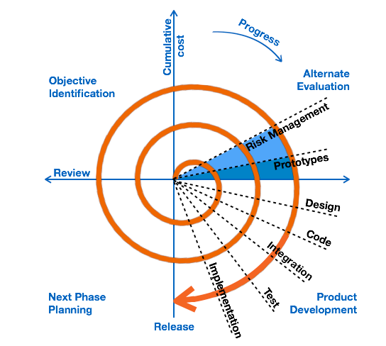
Spiral Model

Slide 17
Spiral Model Application
The Spiral Model is widely used in the software industry as it is in sync with the natural development process of any product, i.e. learning with maturity which involves minimum risk for the customer as well as the development firms.
The following pointers explain the typical uses of a Spiral Model −
When there is a budget constraint and risk evaluation is important.
For medium to high-risk projects.
Long-term project commitment because of potential changes to economic priorities as the requirements change with time.
Customer is not sure of their requirements which is usually the case.
Requirements are complex and need evaluation to get clarity.
New product line which should be released in phases to get enough customer feedback.
Significant changes are expected in the product during the development cycle.

Slide 18
advantages of Spiral Model
Changing requirements can be accommodated.
Allows extensive use of prototypes.
Requirements can be captured more accurately.
Users see the system early.
Development can be divided into smaller parts and the risky parts can be developed earlier which helps in better risk management.

Slide 19
The disadvantages Spiral Model
Management is more complex.
End of the project may not be known early.
Not suitable for small or low risk projects and could be expensive for small projects.
Process is complex
Spiral may go on indefinitely.
Large number of intermediate stages requires excessive documentation.

